Slide 1
Remote Usability
Amir Dirin Spring 2020

Slide 2
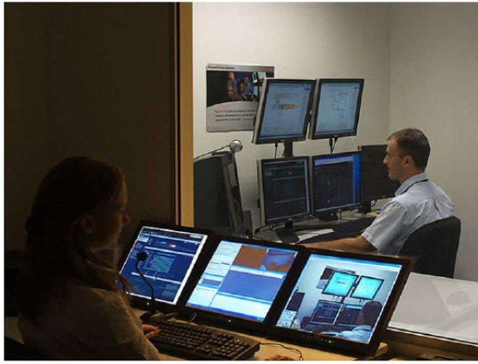
Traditional Usability Testing

Slide 3
Remote Usability Testing
Testing sessions in which the Evaluators and participants are NOT physically in same place.
The testing happens through communications technology and remotely

Slide 4
Remote Testing
Synchronous
One on one and real time
Shared Technology
Remote User Research
A Synchronous
No Moderator
Self-paced
Special tools record activities

Slide 5
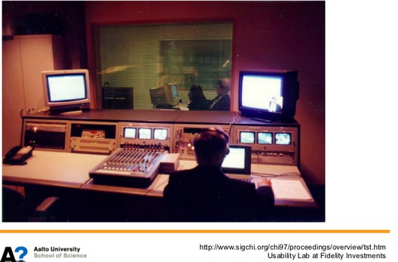
Usability Testing Trends
Movement from usability lab
Testing the application directly in users’ environment
No building of lab is required

Slide 6
Advantages
Save Money
  Travel
  Equipment
Expands sampling population
Ease of Recruitment
Users in their own natural browsing environment

Slide 7
Disadvantages
Users capabilities of using technology
Software installation are not easy specifically beta versions
Tasks are shared in advanced to users / pile of tasks
Participants interrupted or distracted
Security is the main concern
Internet connectivity is important
Not feasible for some measurements, e.g., eye tracking
Constrain on physical movement

Slide 8
When to use
COVID-19
Minimal setup is needed
Rapid testing

Slide 9
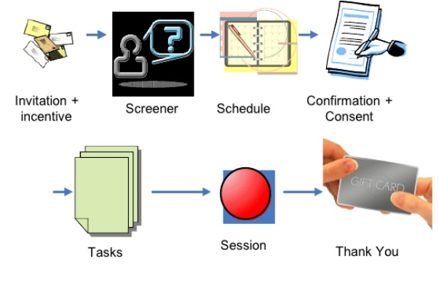
The process

Slide 10
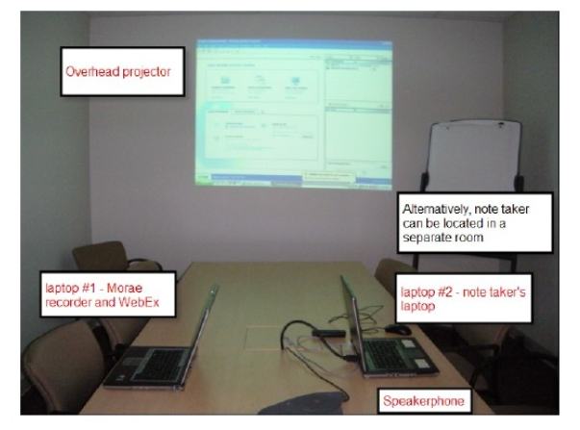
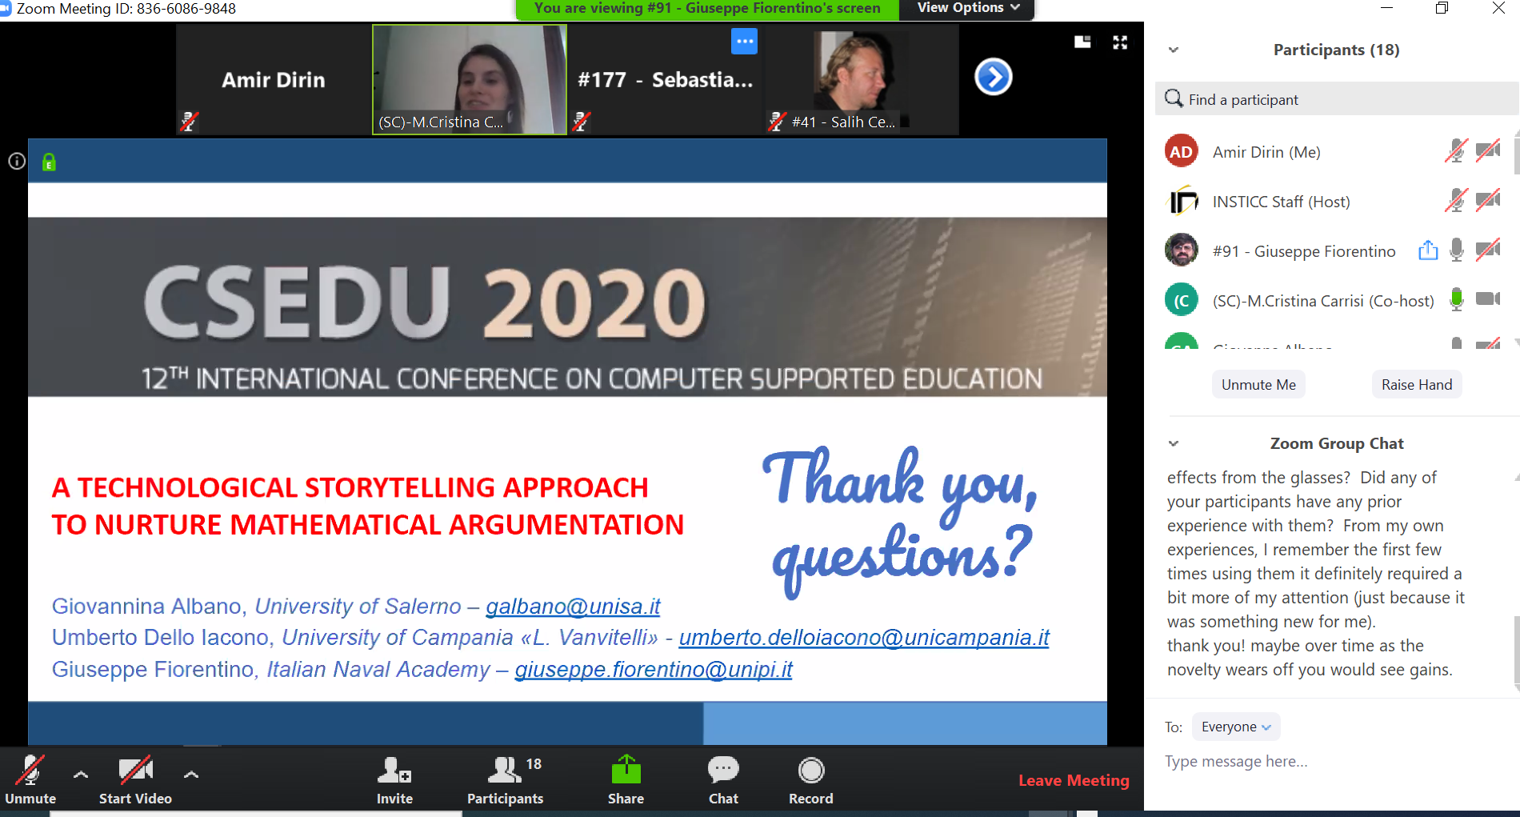
The set-up
Previously
Sunday 03.05.2020 / Zoom

Slide 11
What can go wrong?
User forgets
User can not download everything
The technologies does not work
Takes more time to setup than you anticipate
Very difficult to trace what's going on in user sites

Slide 12
Resources
IBM-Experience remote usability testing

